Slide 1
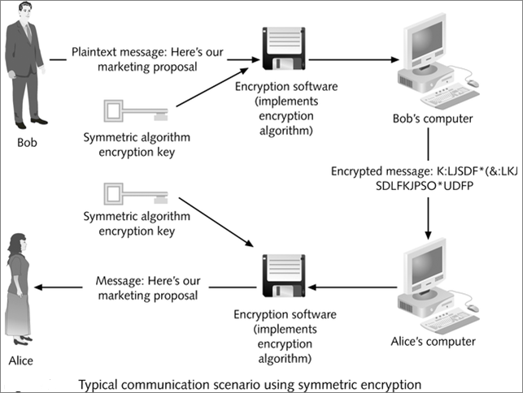
Symmetric Encryption

Slide 2
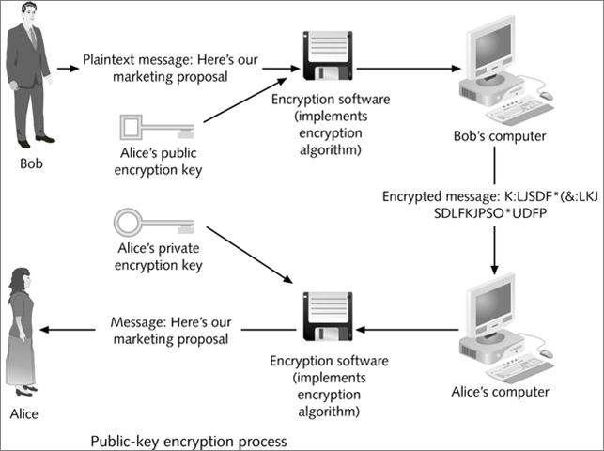
Asymmetric Encryption

Slide 3
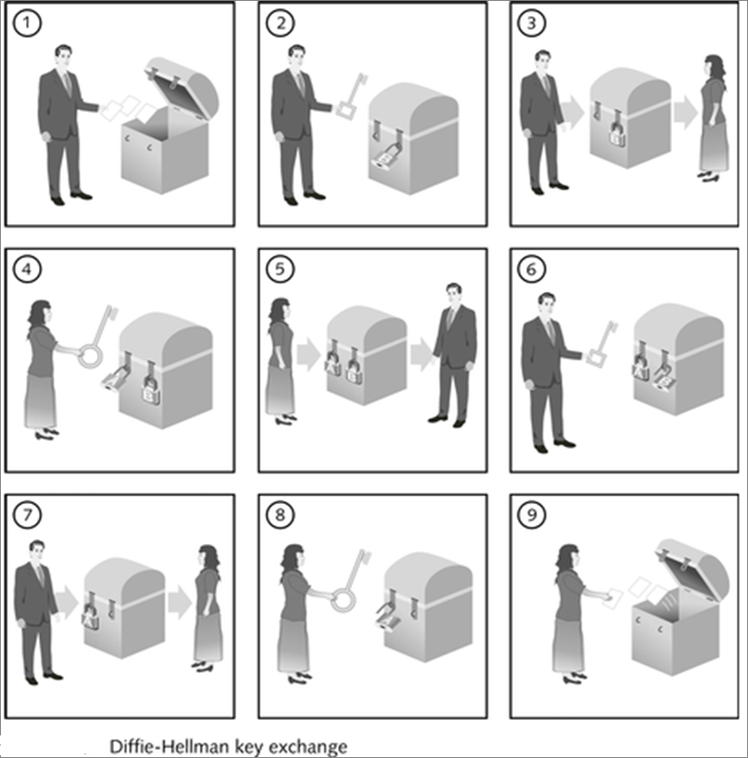
Asymmetric Encryption

